Slide 1
How does Kelly present ideas about bullies and victims in DNA?
Think about and create a mind map of the stereotypical qualities of victims.
Think about and create a mind map of the stereotypical qualities of bullies.

Slide 2
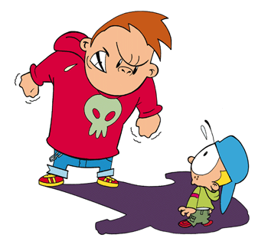
Bullies vs. Victims
Under two separate headings make a list of
who are the bullies
and who are the
victims in the play.
For each character find
evidence to prove their
status.

Slide 3
How does Kelly present ideas about bullies and victims in DNA?
AO1
Respond to texts critically and imaginatively; select
and evaluate relevant textual detail to illustrate and
support interpretations
AO2
Explain how language, structure and form
contribute to writers’ presentation of ideas, themes
and settings

Slide 4
Have a go!
Using the ideas that you have planned answer the question.
Look carefully at the AOs.
How does Kelly present ideas about bullies and victims in DNA?
If you need some hints, look at the next slide for some ideas from AQA.

Slide 5
How does Kelly present ideas about bullies and victims in DNA?
What AQA say:
A01:
Characters who are bullies and characters who are victims; society is
willing to join in bullying of man suspected of killing Adam without
much evidence; some people thrive in a society where bulling
is facilitated; effects of bulling on the perpetrators as well as the
victims
AO2:
Evaluation of effect of characters finishing each others’ sentences
when discussing Adam’s ‘death’; details of Cathy’s behaviour linked with what
she has done; structural effect of Phil’s silences to show effect of being a bully
on him

